Slide 1

ROTATIONAL MOTION
Without any motion or movement there is no life.

Slide 2

Submitted To
Dr. Gurudas Mandal
Chairperson, Professor
Department of Mathematical and Physical Sciences
EAST WEST UNIVERSITY

Slide 3




Submitted By
Name: Ishrat Jahan Momo
Department: Computer Science and Engineering
ID: 2021-3-60-053
Name: Sidratul Moontaha
Department: Computer Science and Engineering
ID: 2021-3-60-048
Name: B M Shahria Alam
Department: Computer Science and Engineering
ID: 2021-3-60-016
Name: Yesmin Akter
Department: Computer Science and Engineering
ID: 2021-3-60-072

Slide 4
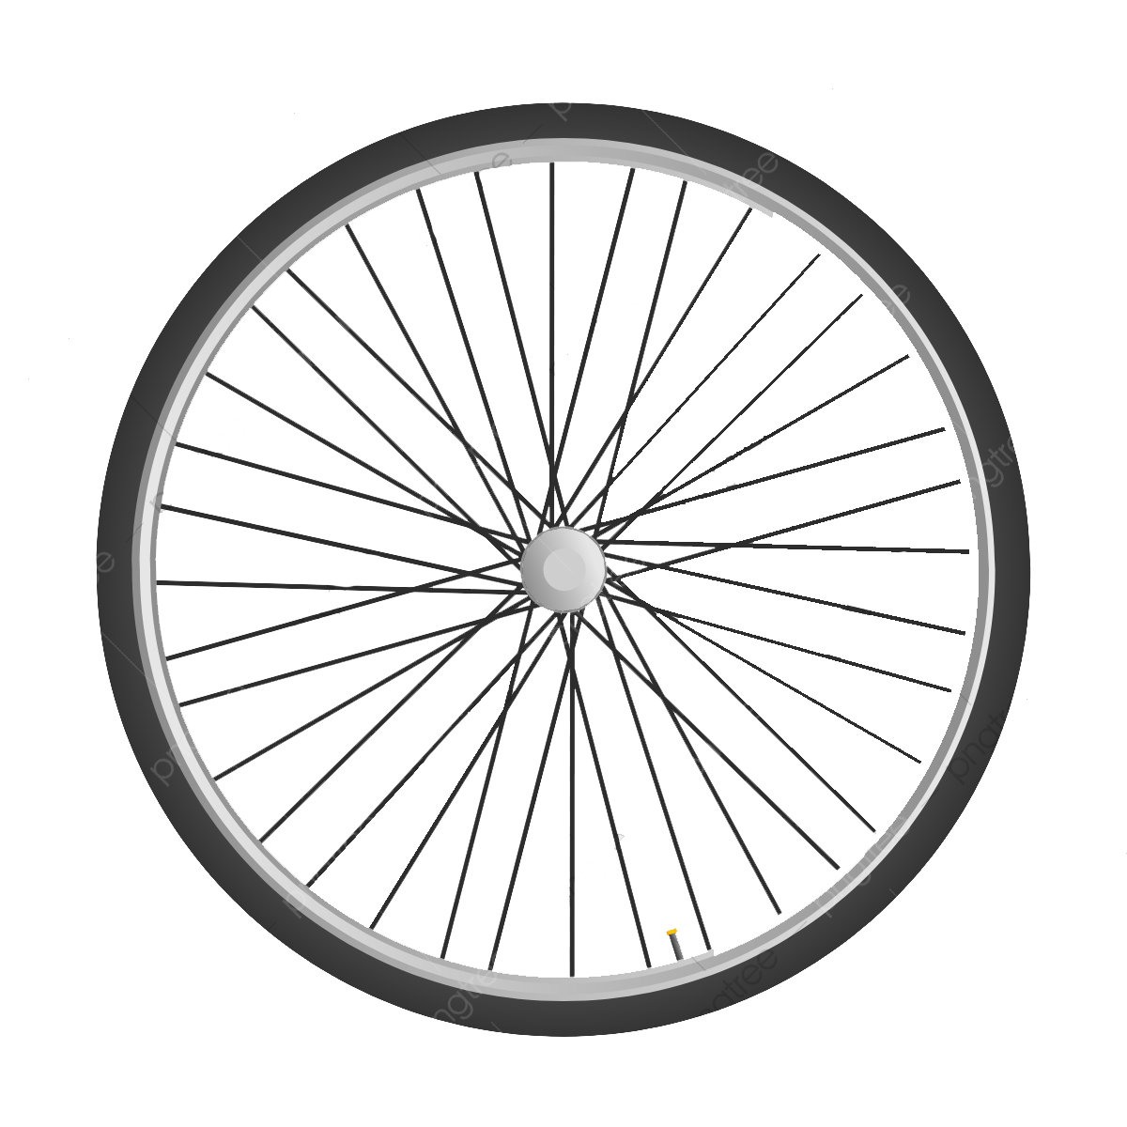
What is Rotational Motion
The motion of a point in a circular path, where the centre point is fixed on the fixed axis of rotation

Slide 5
Types of motion involving rotational motion
01
02
03
Pure rotation
Rotation with rotating axis
Combined translational and rotational motion

Slide 6
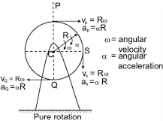
01
Pure rotation
The rigid body in such a motion rotates about a fixed axis that is perpendicular to a fixed plane

Slide 7
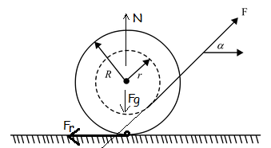
02
Combined translational and rotational motion
A motion that is a combination of rotational and translational motion

Slide 8
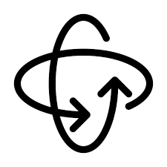
03
Rotation with rotating axis
The straight line through all fixed points of a rotating rigid body around which all other points of the body move in circles.

Slide 9
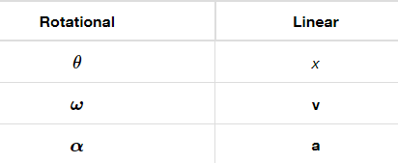
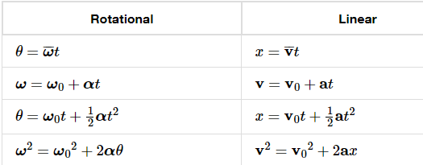
Angular equations of moment

Slide 10
Properties of Rotational Motion
1. It is an accelerated motion :
As the direction of velocity changes at every instant, it is an accelerated motion.
a=(dv/dt)
2.It is a periodic motion :
During the motion the particle repeats its path along the same trajectory. Thus the motion is periodic.

Slide 11

Rotational motion parameters
01
Angular displacement
02
Angular velocity
03
Angular acceleration
04
Torque
05
Moment of inertia
06
Angular momentum

Slide 12
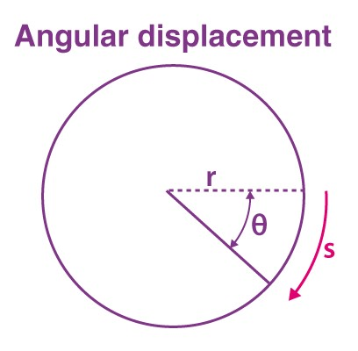
01
Angular displacement
The radian value of the angle displaced by an object on the centre of its path in circular motion from the initial position to the final position is called the angular displacement

Slide 13
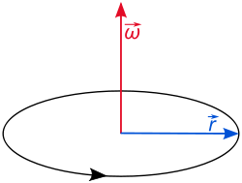
02
Angular velocity
Angular velocity is a pseudo vector representation of how fast the angular position or orientation of an object changes with time.

Slide 14
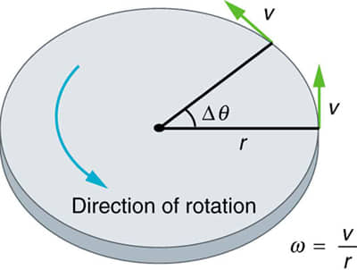
03
Angular acceleration
Angular acceleration refers to the rate of change of angular velocity. There are two types of angular velocity.

Slide 15
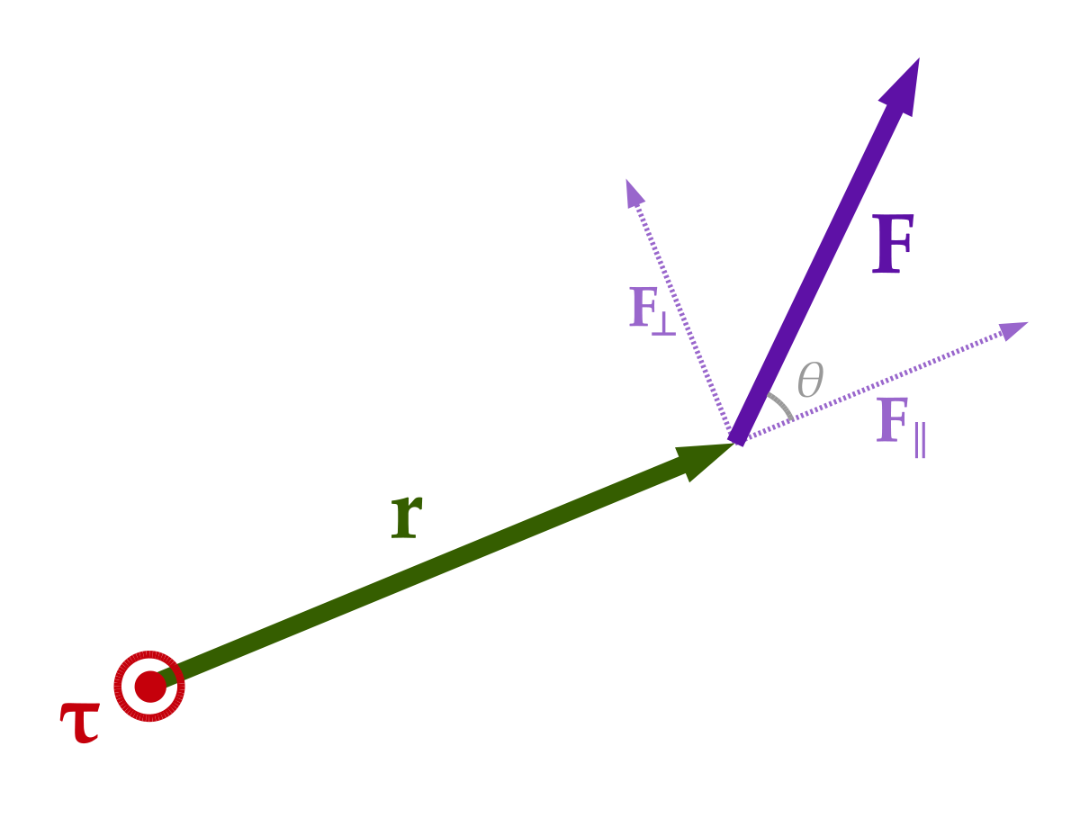
04
Torque
Torque is called the moment of force and is a measure of the turning effect of the force about a given axis.
The rate of change of angular momentum of an object in rotational motion is proportional to the external unbalanced torque. The direction of the torque also lies in the direction of the angular momentum.

Slide 16
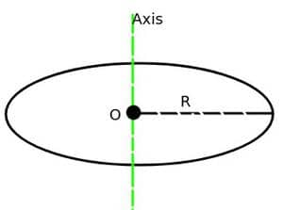
05
Moment of Inertia
Unlike the case of linear movement's inertia, inertia of rotational motion depends both upon the mass of the object and the distribution of mass.

Slide 17
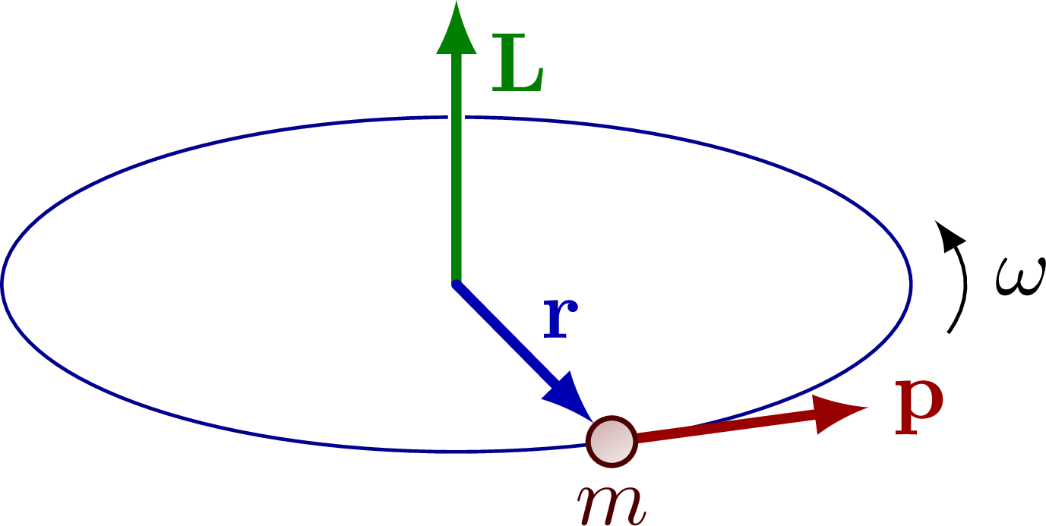
06
Angular Momentum
Angular momentum is the product of the moment of inertia and the angular velocity of the object.

Slide 18
Uses of Rotational Motion in real life
01
Fans
02
Toys such as tops
03
Wheels on vehicles
04
Clock Ticking
05
Kitchen Blenders
06
Rotation of Earth

Slide 19
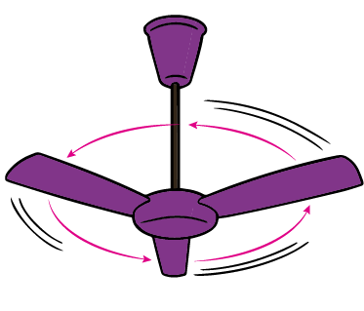
Real life Examples
Fans
The blades of a fan are attached to a central hub, which is further connected to a motor present inside the internal circuitry of the appliance. The blades of the fan spin and exhibit rotatory motion.

Slide 20
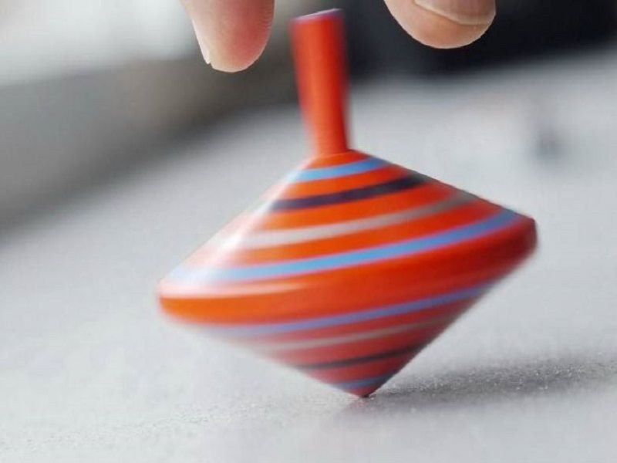
Real life Examples
Toys such as tops
When the spinning top is placed on a surface such that only its pointed end is in contact with the ground and the thread is pulled with force, the top spins about its own axis till the energy possessed by the top gets consumed thoroughly.

Slide 21
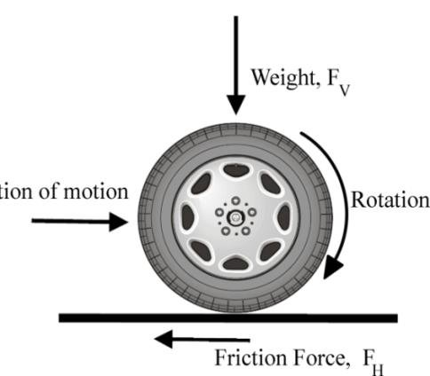
Real life Examples
Wheels on vehicles
The wheels of a vehicle rotate with respect to the axle. This rotation of the wheels helps to move the vehicle in the forward or reverse direction. The motion of the wheels demonstrates the rotatory motion, whereas the motion of the car is the result of the conversion of rotational motion into linear motion.

Slide 22

Real life Examples
Clock Ticking
The minute, hour, and second hand of a clock rotate in a circular direction, keeping the pinpoint as the centre or the axis of rotation. Hence, the hands of a clock are said to be exhibiting rotatory motion.

Slide 23
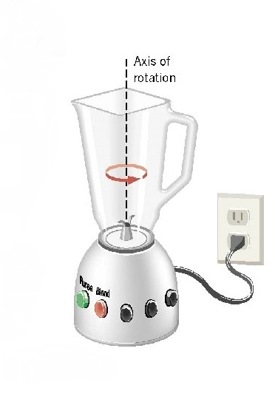
Real life Examples
Kitchen Blenders
A blender is one of the most common examples of rotatory motion in real life. When the power switch of a blender is pressed, the motor present inside the internal circuitry of the appliance helps the blades rotate and display rotary motion.

Slide 24
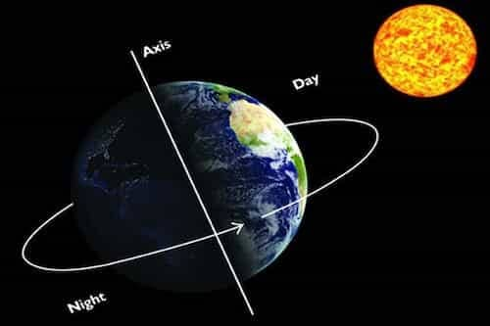
Real life Examples
Rotation of Earth
As the name itself suggests, the motion of the earth and other planets about their respective axis is an example of rotatory motion. This spinning of the celestial bodies about their central position is a result of inertia.

Slide 25
Thank You

